Slide 1







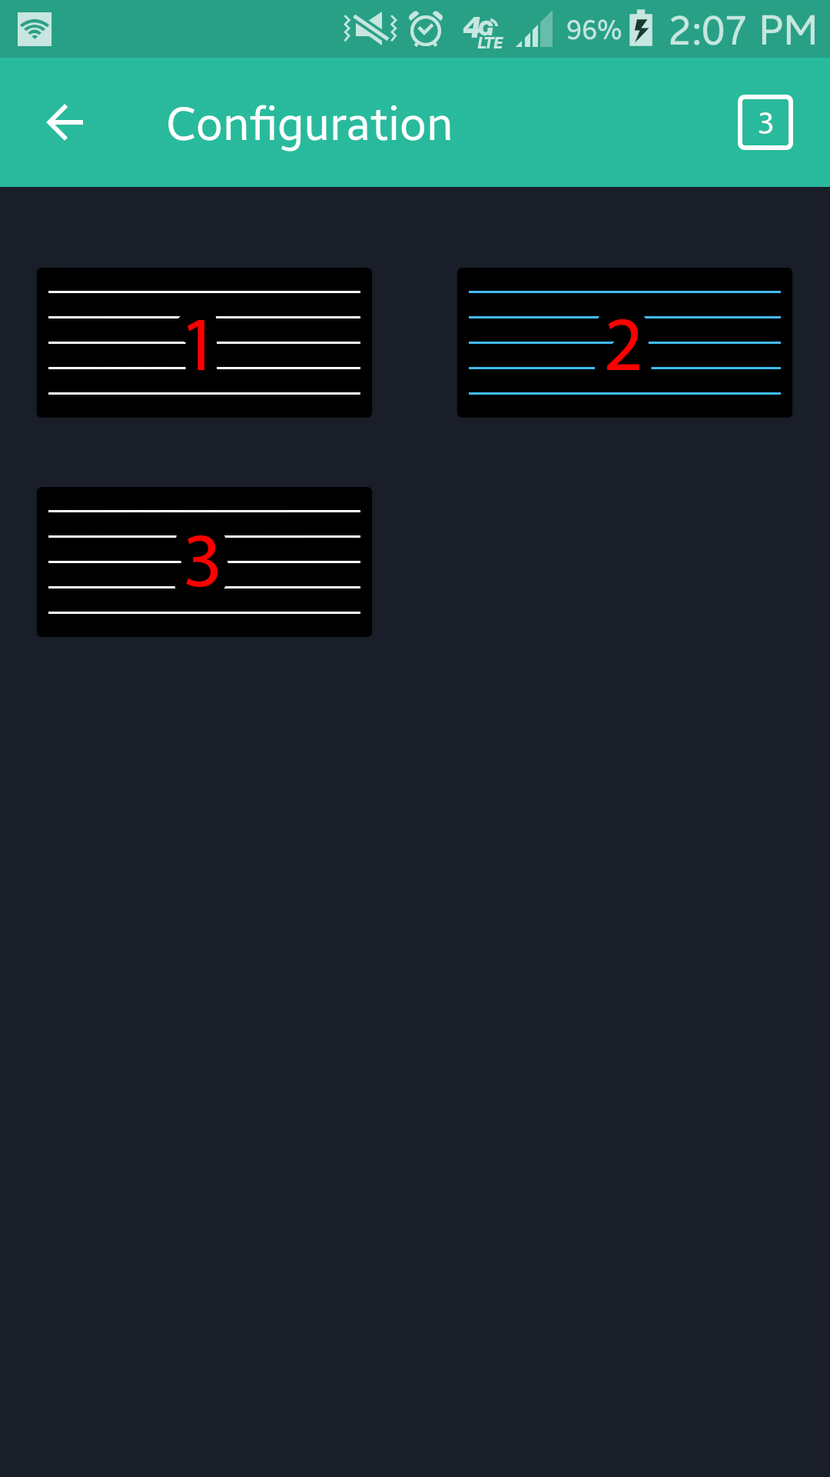
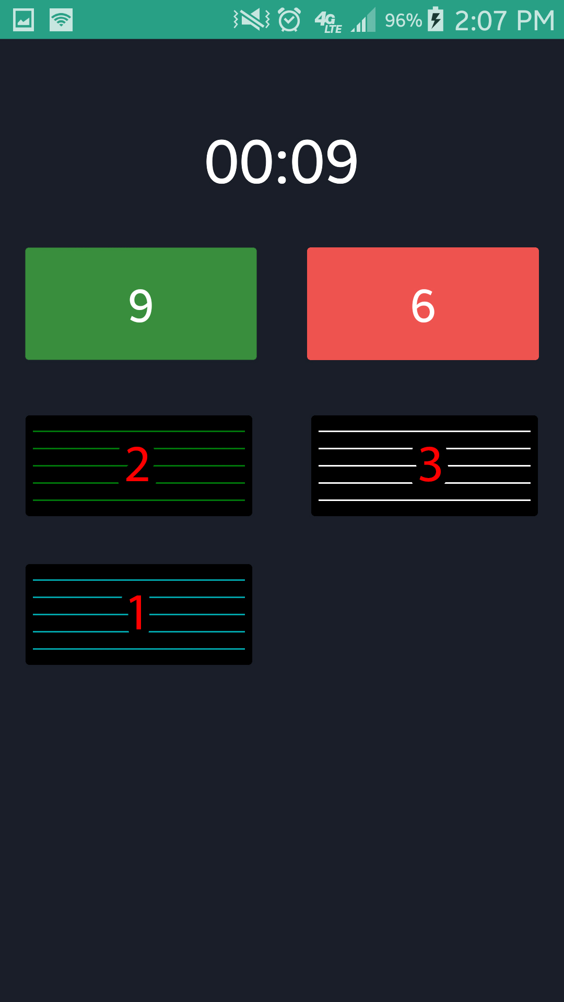
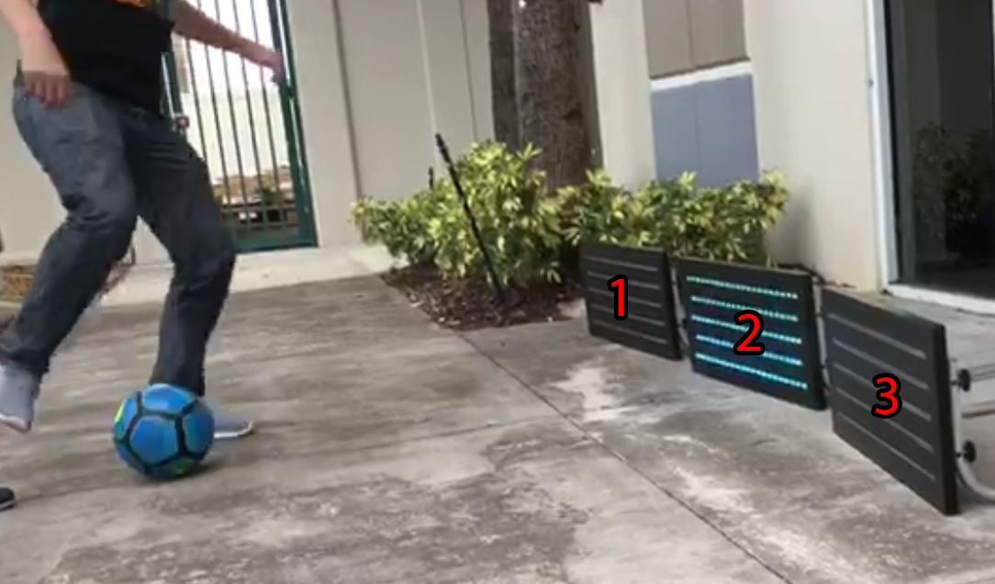
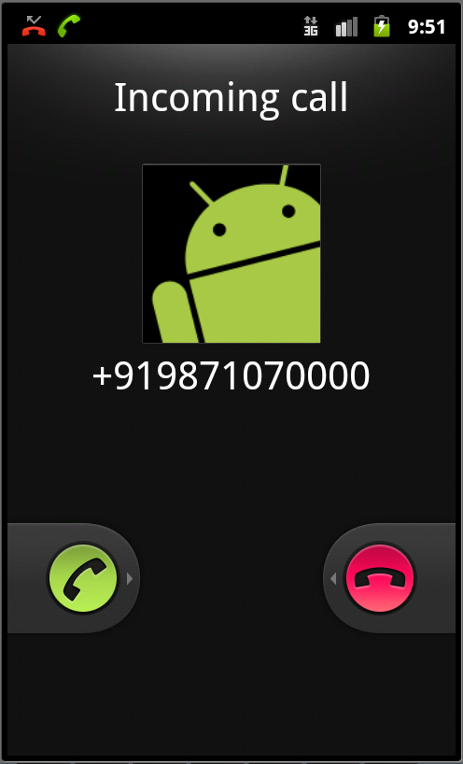
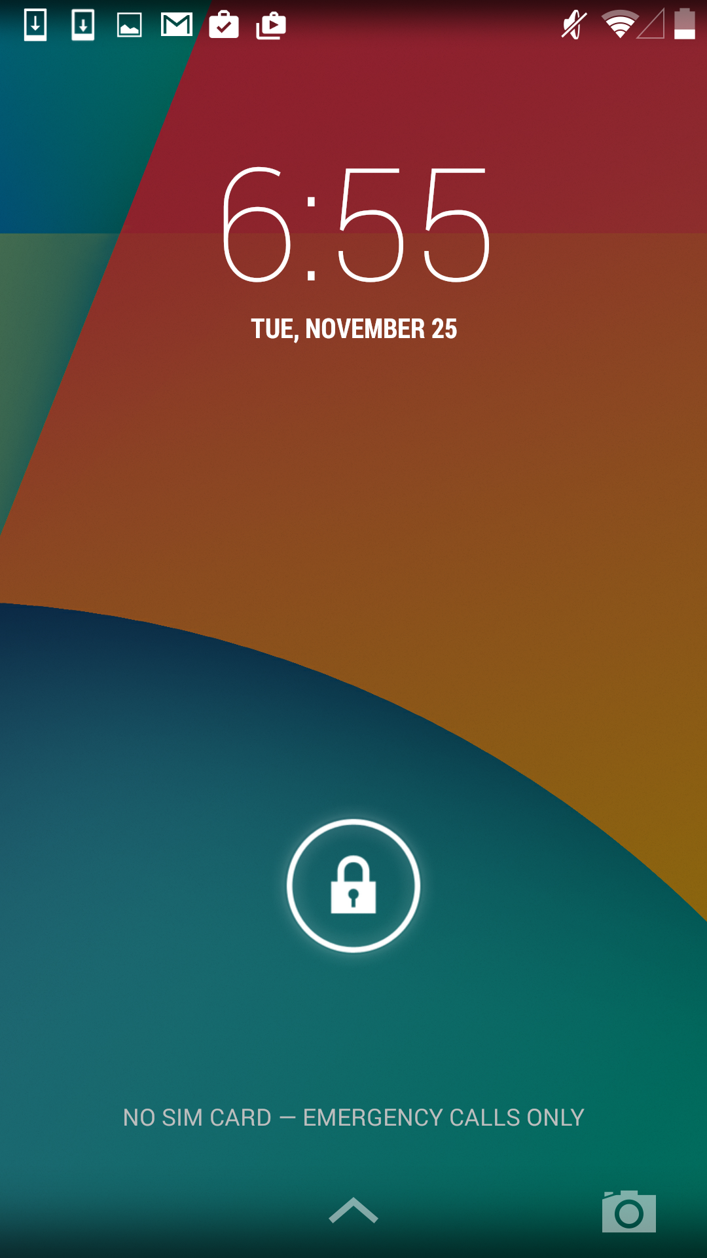
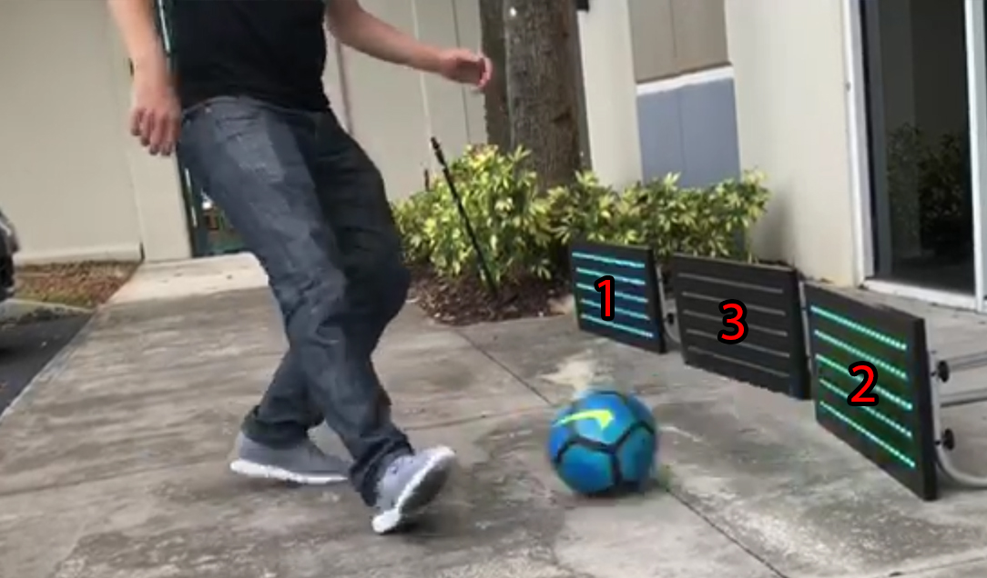
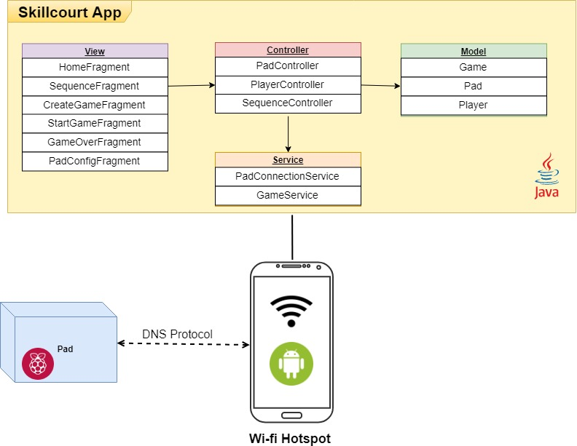





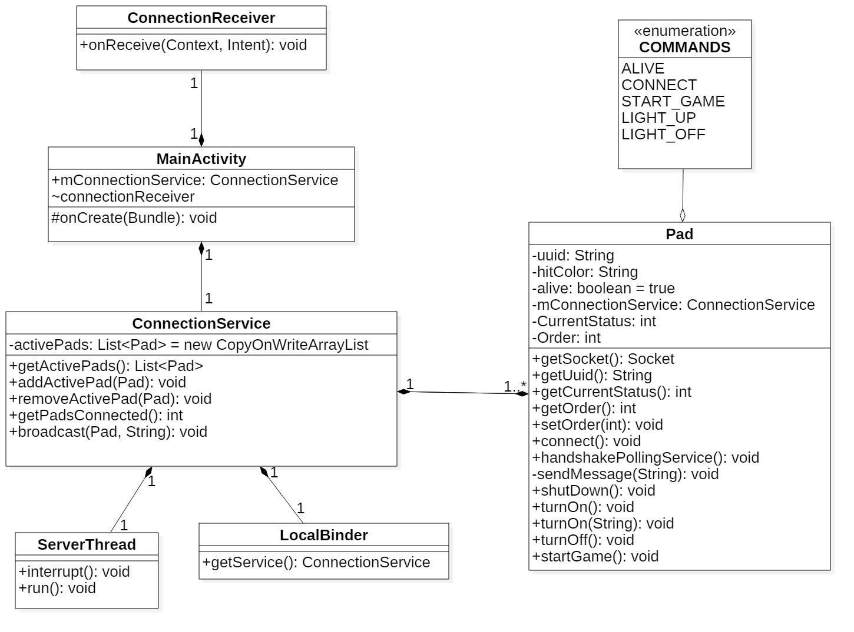


School of Computing & Information Sciences
Senior Project (Spring 2018)
SkillCourt Soccer Training System v.10
Student: Carlos Alva, Florida International University
Mentor: Joshua McLendon, Florida International University
Professor: Masoud Sadjadi, Florida International University
Problem
Current software architecture does not provide a way to implement a personalized training system.
Pad connection is lost when App is minimized or screen locks interrupting the current playing game.
No architecture implemented to assign a an specific order to a Pad
Current System
SkillCourt provides an innovative soccer training system that facilitates the improvement of key skills for soccer players.
Limited on functionality and customization
Pad connection is not reliable
Solution
Re-design the system architecture such that adding new game modes and features is simpler and more efficient.
Refactoring of Pad connecting service, such that the reliability of the pads improves and connectivity runs as a background service.
Create Back-end to support Pad ordering
Don’t let anything stop you
Modify Pad order to increase difficulty
Customizable Sequence Game Mode
Multi-task
Train even after Screen locks or timeouts
Requirements
Better architecture that guarantees:
- Scalability, - Reliability, - Simple addition of new features: i) Identify ordering of Pads ii) Play sequence iii) Colored Pads
As a User I should Play a full game without Pad disconnecting when phone locks
As a User I should assign an order to a Pad so I can play Sequence Game mode
System Design
Implementation
Design: StarUML, Draw.IO
Development: Android Studio, Gradle
Testing: Junit 4, Mockito
Verification
Unit test: SC-1152_SendHtmlHexColorCode: Given there exist a Socket connection, and API call to turnOn(FF0000) should make call to message() with String containing “FF0000”.
Regression testing with Pad Emulator tool and latest firmware version of Hardware Pads
Object Design
Summary
SkillCourt 10.0 now provides a more robust Pad connection system, and a Object-Oriented architecture created with future features in mind.
Personal contribution:
Configuration Screen Pad ordering system (Back-end)
Pad Connection as a background service
Acknowledgement
Thank you to my Teammates Sandra Hurtado and Sergio Rosales, and our mentor Joshua McLendon
FOLLOW US @FIUSCIS
Notes:
Soccer coaches require better tools to track the performance of individual players. Soccer being the most popular sport in the world, the need for a fully customizable application that lets you improve key soccer skills on a fun, affordable and professional way is in high demand.
1

